Slide 1


M.Sc. AIML Semester – VI CC-314 & CC-315 Mini Project-I Internal Presentation
Roll No. | 12 15
Name | Mit Thaker Alok Patel
Title | Plant Leaf Disease Detection Through CNN.
Mentor’s Name | Saurabh Das
Department of AIML and Data Science School of Emerging Science & Technology Gujarat University

Slide 2

Table of Content
Introduction
Literature Review
Methodology
Results
Conclusion
References

Slide 3

Introduction
Leaf disease detection is a crucial task in agriculture, as it enables early identification and management of plant diseases.
Diseases found in agriculture crops is major threat that cause production and economic losses as well as reduction in both quantity and quality of agriculture products.
Traditional methods of disease identification often involve manual inspection by experts, which can be time-consuming and labor-intensive.
With advancements in computer vision and machine learning techniques, automated systems for leaf disease detection have become increasingly popular and effective.
Convolutional Neural Networks (CNNs) have emerged as a powerful tool for image classification tasks, including leaf disease detection.

Slide 4

Literature Review

Slide 5
Ozen, Sardogan, Tuncer (2018) propose a method for detecting and classifying plant leaf diseases. Their approach combines Convolutional Neural Networks (CNN) for feature extraction with the Learning Vector Quantization (LVQ) algorithm for classification. The study evaluates the method using a dataset of diseased plant leaf images, achieving accurate classification results. This approach offers promise for automated plant disease monitoring in agriculture, contributing to improved crop health management and productivity.
Das, Dey and Shrestha (2020) investigate CNNs for plant disease detection. CNNs offer automated solutions, learning features from images. Their study highlights CNN architectures, transfer learning, and datasets like Plant Village. Challenges include interpretability and computational efficiency. Recent advances aim at improving interpretability and generalization. This study adds to the growing research on CNN-based plant disease detection, showing potential for transforming agriculture.
Deepalakshmi et al. (2021) present a study in the International Journal of Information System Modeling and Design (IJISMD) focusing on using CNN algorithms for plant leaf disease detection. They leverage CNNs to automatically detect diseases in plant leaves, addressing challenges such as dataset diversity and model robustness. Their work contributes to automating disease detection in agriculture, potentially enhancing crop yields and food security

Slide 6
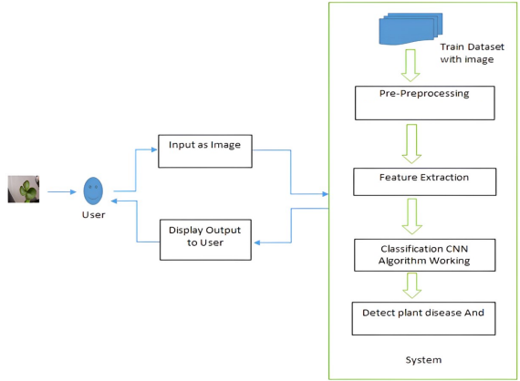
Methodology

Slide 7
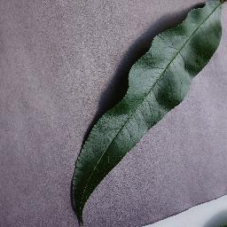
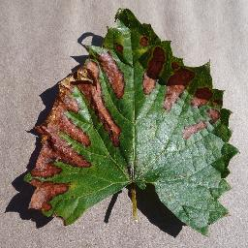
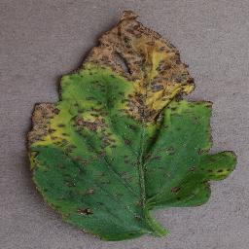
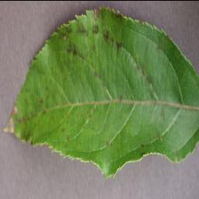
Data Collection
There are 87K RGB images of healthy and diseased crop leaves across 38 classes. Split into 80/20 training and validation sets, preserving directory structure. An additional directory with 33 test images created for prediction.
Train images :70295
Test images: 33
Validation :17572

Slide 8
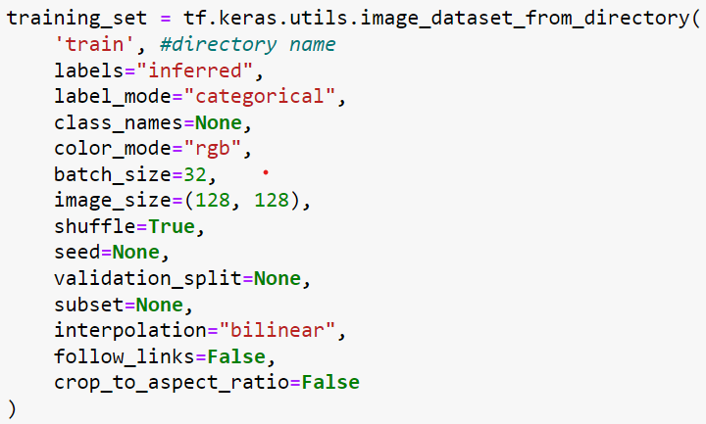
Data Preprocessing
It includes Standardize image sizes, normalize pixel values, and apply augmentation techniques to enhance dataset variability and quality.
It loads images from the 'train' directory.
Images are labeled using inferred labels.
Labels are encoded in categorical format.
Images are resized to 128x128 pixels.
Data is shuffled, and a batch size of 32 is used for training.

Slide 9
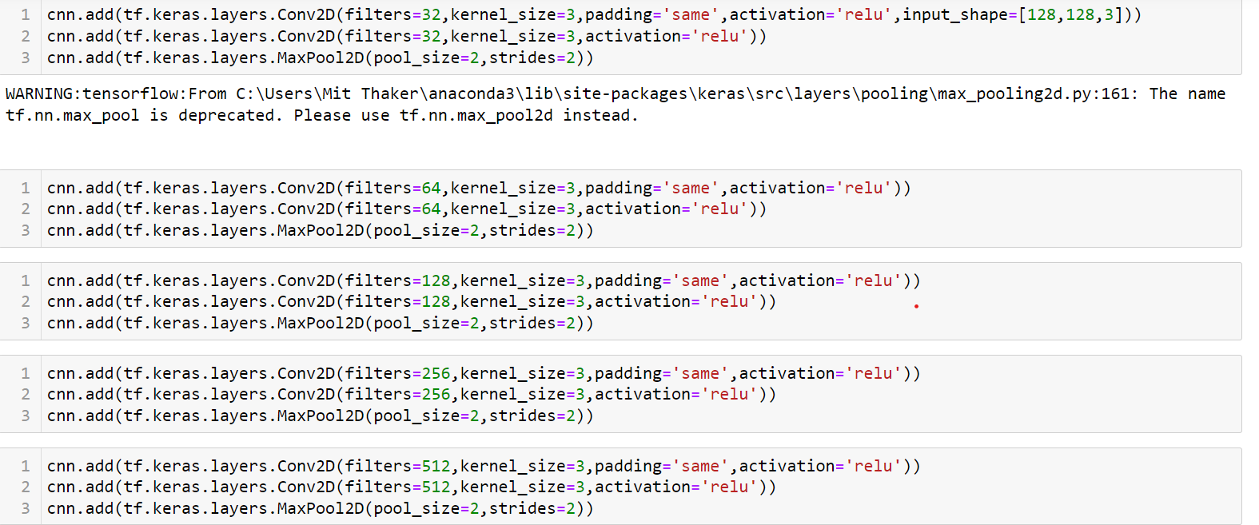
Feature extraction is done through convolutional layers (Conv2D) and max-pooling layers (MaxPool2D). Convolutional layers apply filters to input images, extracting features like edges and textures. Activation functions (ReLU) introduce non-linearity. Max-pooling layers down-sample feature maps, retaining essential information. Together, these layers capture and refine features from the input images, enabling the network to learn meaningful representations for classification.
Feature Extraction
Notes:
Convo 2d : special filters (imp feaatuers) , relu : whether the feature is imp or not , mx : works as simplifier .

Slide 10
Classification CNN Algorithm working: Input pre-processed leaf images into the CNN architecture. Forward propagate the images through the convolutional layers to extract hierarchical features. Flatten the feature maps and pass them through fully connected layers for classification. Calculate the loss between predicted and true labels and backpropagate gradients to update model parameters. Iterate through multiple epochs of training, adjusting model weights to minimize classification error.
Disease Detection: Deploy the trained CNN model to detect diseases in new leaf images, leveraging the extracted features and classification capabilities to identify and categorize diseases accurately.

Slide 11

Convolutional Neural Network
Convolutional Neural Networks, are specialized artificial neural networks designed for processing visual data.
They use layers that analyze small regions of an image, learn features, and gradually combine them to recognize complex patterns.
CNNs excel in tasks like image recognition, object detection, and classification due to their ability to automatically extract relevant features from raw data.

Slide 12
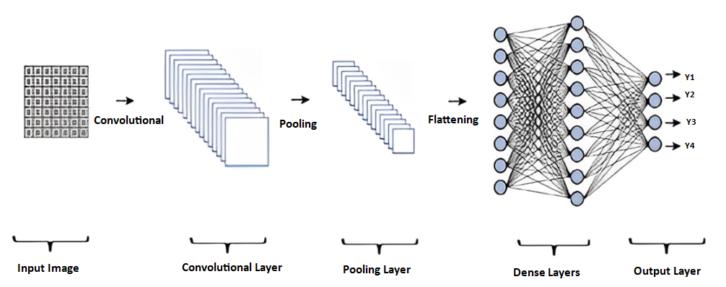
Convolutional Neural Network Architecture
Convolutional layer: Produces an activation map by scanning the pictures several pixels at a time using a filter.
Pooling Layer :Reduces the amount of data created by the convolutional layer so that it is stored more efficiently.
Dense layers: They are fully connected layers where each neuron is connected to every neuron in the preceding layer.

Slide 13
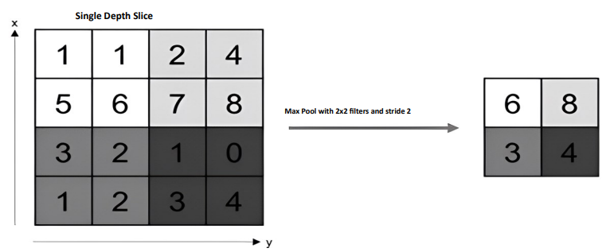
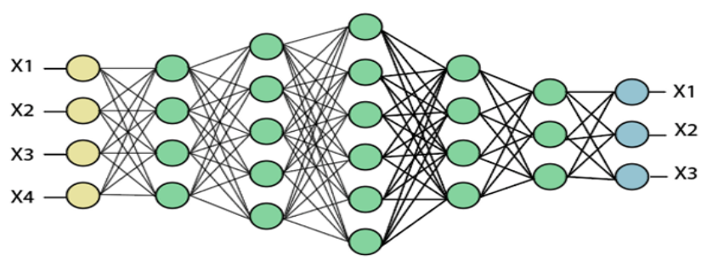
Fully Connected Layer ‘s
Fully connected input layer – The preceding layers output is "flattened" and turned into a single vector which is used as an input for the next stage.
The first fully connected layer – Adds weights to the inputs from the feature analysis to anticipate the proper label.
Fully connected output layer – Offers the probability for each label in the end.

Slide 14

Results
Accuracy
Graphs
Website images

Slide 15
Accuracy
Training accuracy : 0.983483910560
Validation accuracy: 0.953448653221

Slide 16
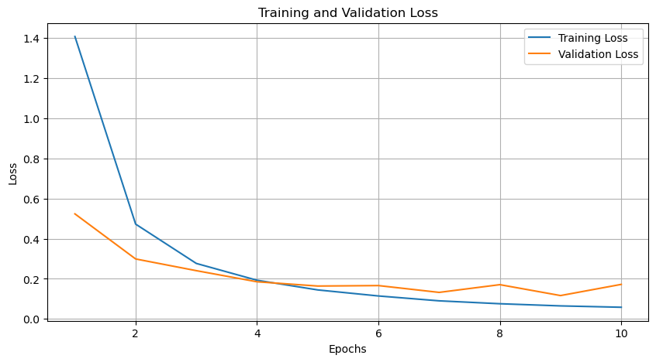
Graphs: Training and Validation loss

Slide 17
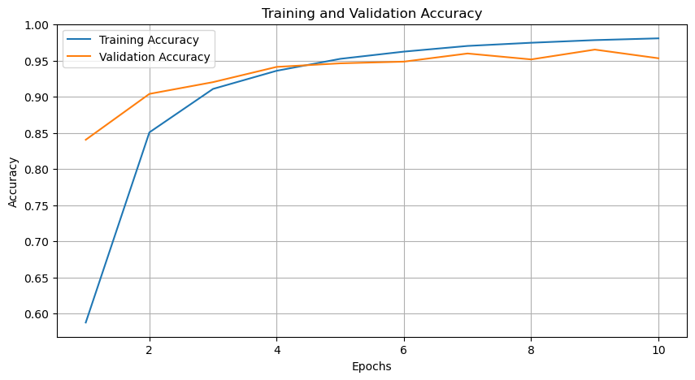
Graphs: Training and Validation Accuracy

Slide 18
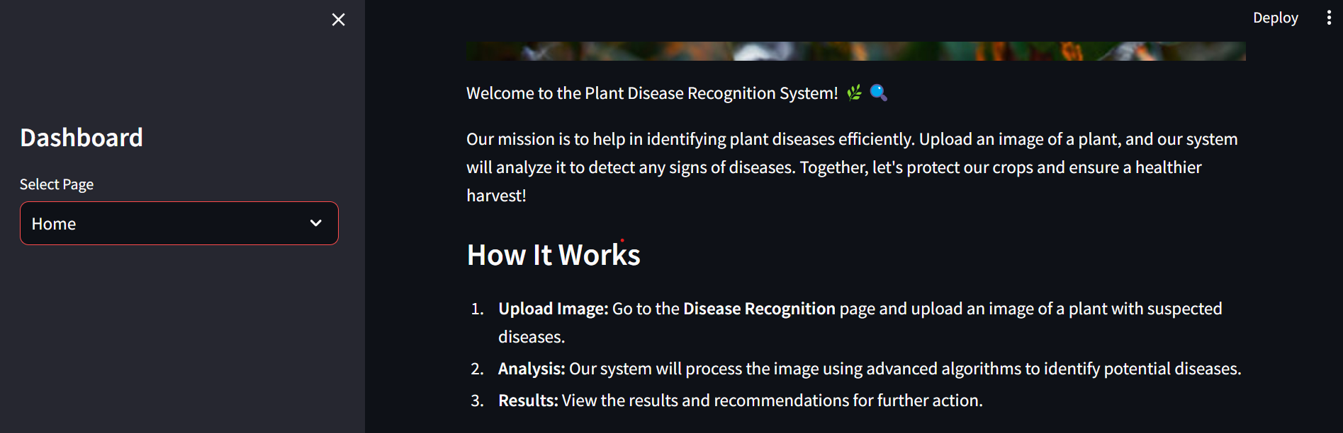

Slide 19
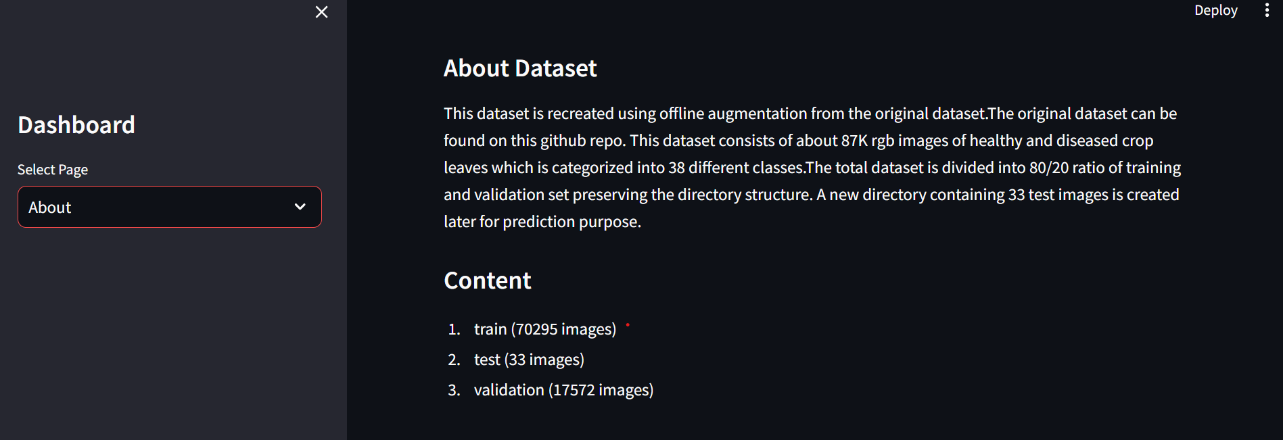

Slide 20
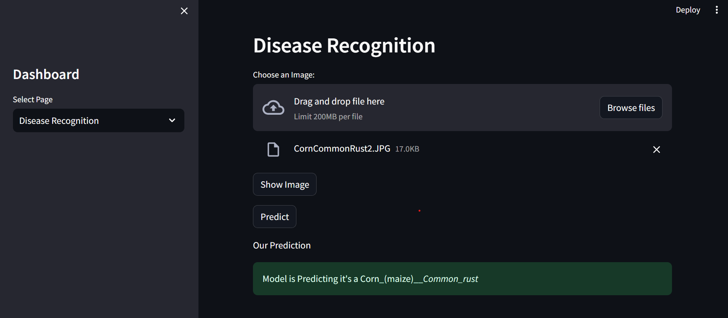

Slide 21

Conclusion
In conclusion, the project demonstrated the effectiveness of deep learning techniques in detecting plant leaf diseases. The project achieved high accuracy rates in classifying the different types of plant leaf diseases using a Convolutional Neural Network (CNN) architecture.
Furthermore, the project's helps farmers make informed decisions about the most effective treatment for their crops.
With further advancements in technology and the integration of precision agriculture techniques, the future of plant leaf disease detection and agriculture can become more efficient, sustainable, and productive.

Slide 22

References
1.) Ozen, Y. , Sardogan, M., & Tuncer, A., (2018, September). Plant leaf disease detection and classification based on CNN with LVQ algorithm. In 2018 3rd international conference on computer science and engineering (UBMK) (pp. 382-385). IEEE.
2.) Das, M., Dey, N. & Shrestha, G. (2020, October). Plant disease detection using CNN. In 2020 IEEE applied signal processing conference (ASPCON) (pp. 109-113). IEEE.
3.) Deepalakshmi, P., Lavanya, K., & Srinivasu, P. N. (2021). Plant leaf disease detection using CNN algorithm. International Journal of Information System Modeling and Design (IJISMD), 12(1), 1-21
Dataset-link: https://www.kaggle.com/datasets/vipoooool/new-plant-diseases-dataset

Slide 23

Thank You

